Slide 1
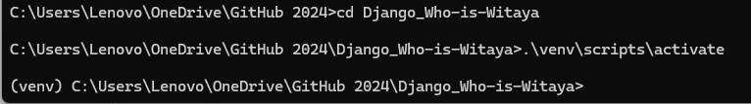
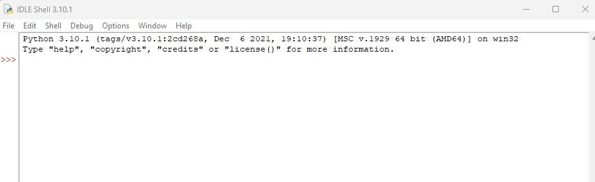
Jan_13_2024
1.Pip install virtualenv
2.C:\Users\Lenovo\OneDrive\GitHub 2024>python -m virtualenv venv or python –m venv myname
created virtual environment CPython3.10.1.final.0-64 in 12014ms
creator CPython3Windows(dest=C:\Users\Lenovo\OneDrive\GitHub 2024\venv, clear=False, no_vcs_ignore=False, global=False)
seeder FromAppData(download=False, pip=bundle, setuptools=bundle, wheel=bundle, via=copy, app_data_dir=C:\Users\Lenovo\AppData\Local\pypa\virtualenv)
added seed packages: pip==23.2.1, setuptools==68.1.2, wheel==0.41.2
activators BashActivator,BatchActivator,FishActivator,NushellActivator,PowerShellActivator,PythonActivator
3.C:\Users\Lenovo\OneDrive\GitHub 2024\Who-is-witaya>.\venv\scripts\activate or .\name virtual environment \Scripts\activate
4.(venv) C:\Users\Lenovo\OneDrive\GitHub 2024\who-is-witaya
>>> .\venv\scripts\activate.ps1 if activate with Power shell ( Add .ps1)
https://www.youtube.com/watch?v=rRVWQCpZ_CI&t=3208s (ลุงวิศวกร )
File new is editor to do tkinter ( pip install tk)

Slide 2
Pending study
404 or error and exception
Barcode
Line barcode
Mongo_DB
Postage
Firebase
Python UbanTU Server
CSV to Database
Context processer
Django-admin start project Who-is Witaya Django-admin start app Home python manage.py migrate python manage.py create super user MTV concept

Slide 3
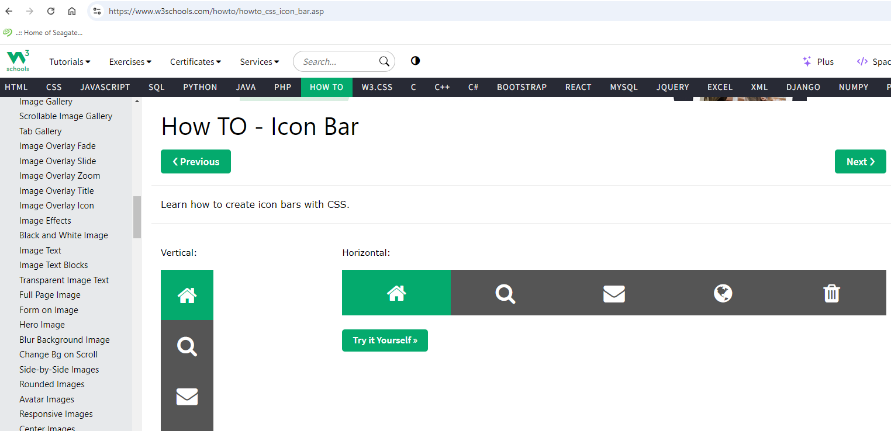
https://startbootstrap.com/previews/sb-admin ( dashboard)
https://www.w3schools.com/howto/howto_css_icon_bar.asp
https://www.w3schools.com/w3css/tryit.asp?filename=tryw3css_templates_architect&stacked=h

Slide 4
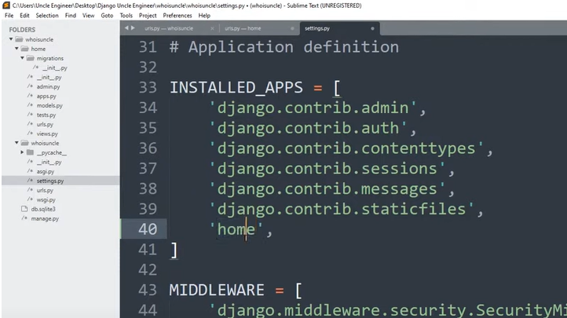
App Home

Slide 5
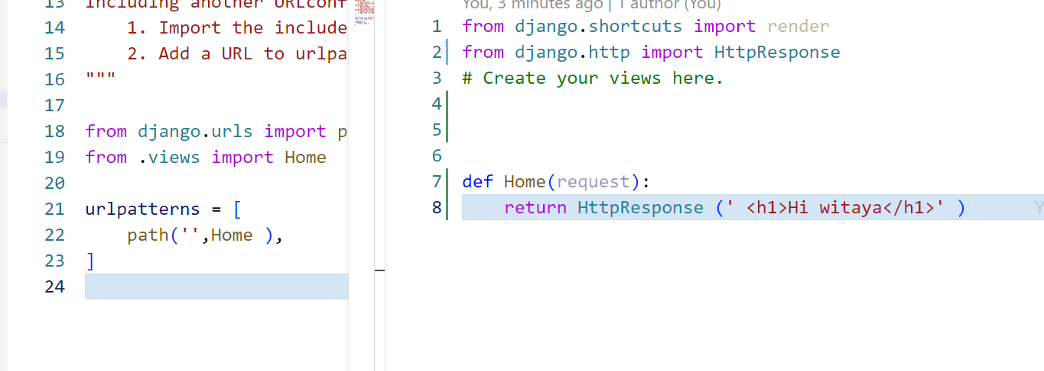
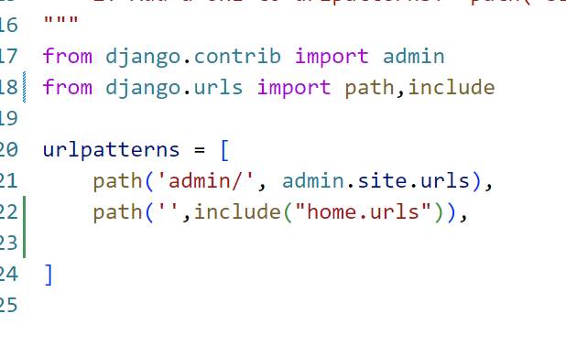
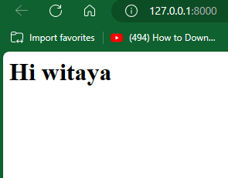
Project
App home
Function on view
Looking url in home app

Slide 6
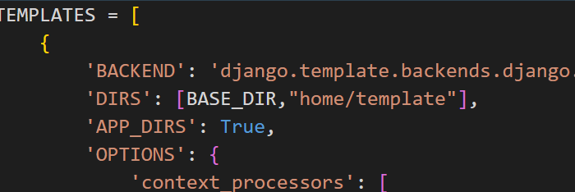
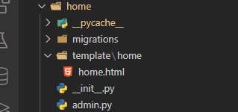
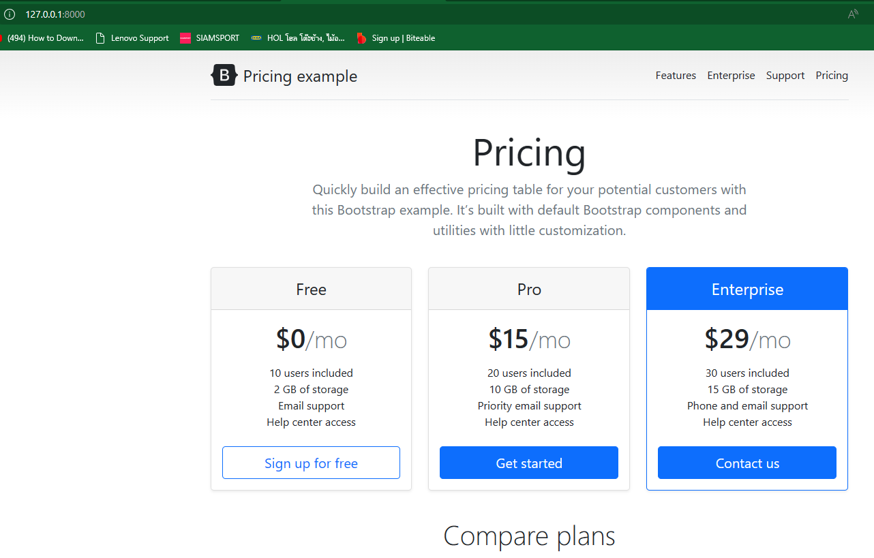
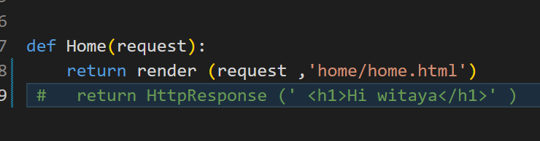
https://getbootstrap.com/docs/5.3/examples/pricing/ ตัวอย่างหน้า Web
เอามาใส่หน้า html template [Folder] /home ( Folder) =➔ Home.html
แก้ views เป็น render
แจ้ง project ว่า.App is template from whois witaya\home\template\home\home.html

Slide 7
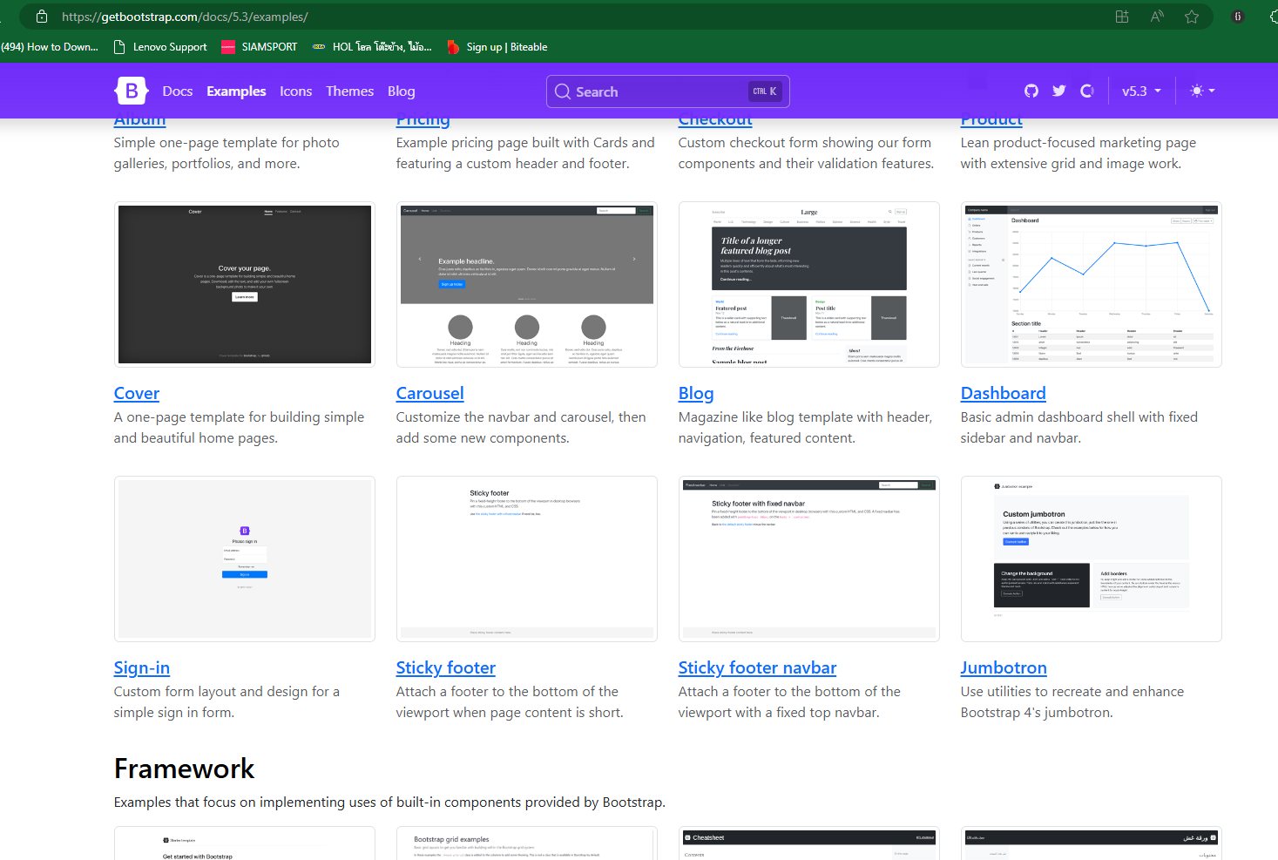

Slide 8
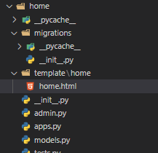
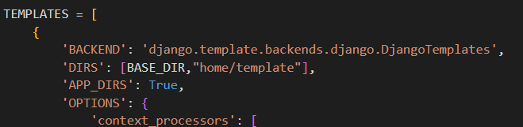
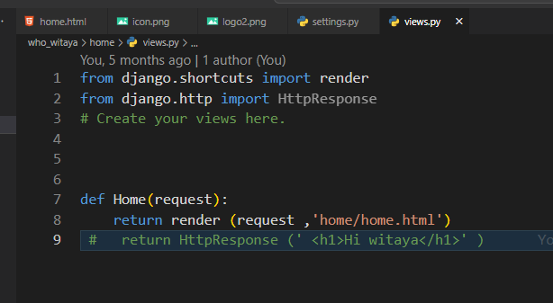
How to create template
Add folder template on app /// add folder home // add home.html
Setting.py add ( BASE_DIR, ’home/template ‘),
Use render instead of HTTP respond
App
Folder
Header
Body [How to add link /side bar /carousel /picture ]
FOOTER

Slide 9
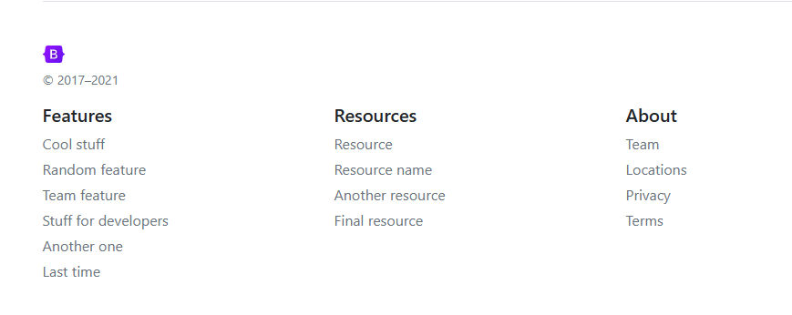
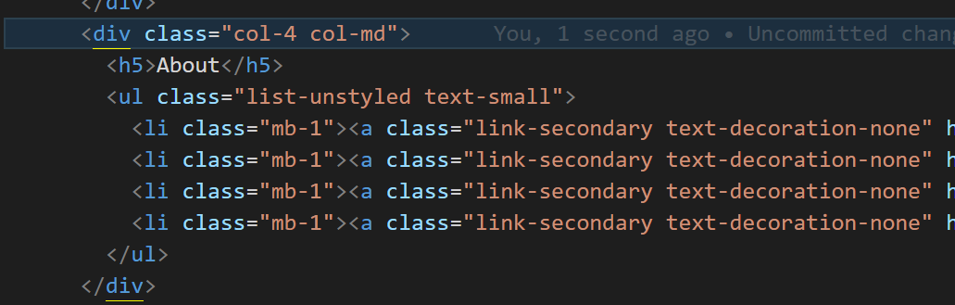
Change from 6 to 4 เป็น 3 ช่องอยู่ด้วยกัน

Slide 10
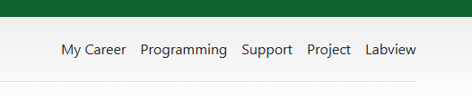
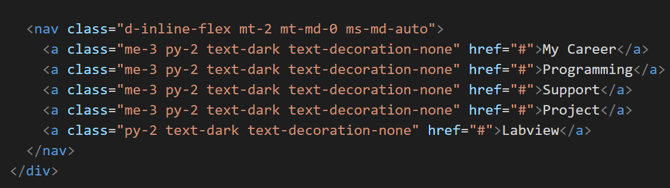
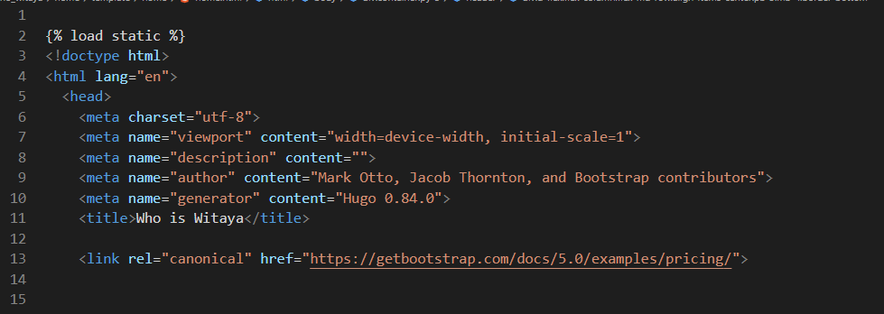
Nav-bar
แก้ไข Link

Slide 11
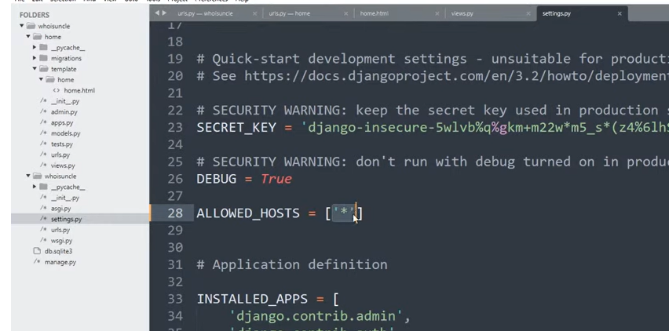
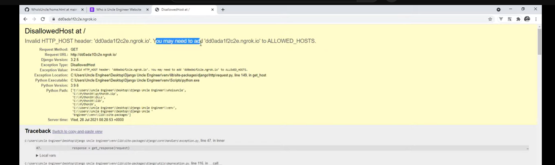
https://github.com/UncleEngineer/WhoIsUncle/blob/main/home.html
1.install sw ngrok
2.การใช่งาน Ngrok forwards with Ngrok use our computer is server
ngrok http 8000 or . \ngrok http 8000
3.Click link
Witaya nrok is witaya.chaison@gmail.com
Ikea Web : witaya.chaison@gmail.com
https://dashboard.ngrok.com/get-started/your-authtoken
https://www.youtube.com/watch?v=aFwrNSfthxU

Slide 12
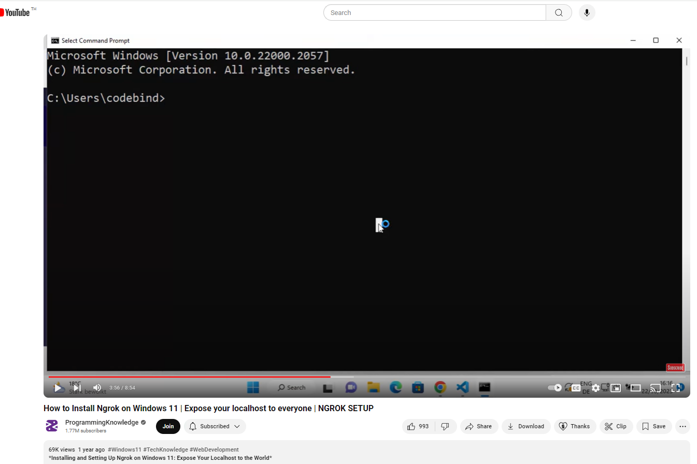

Slide 13
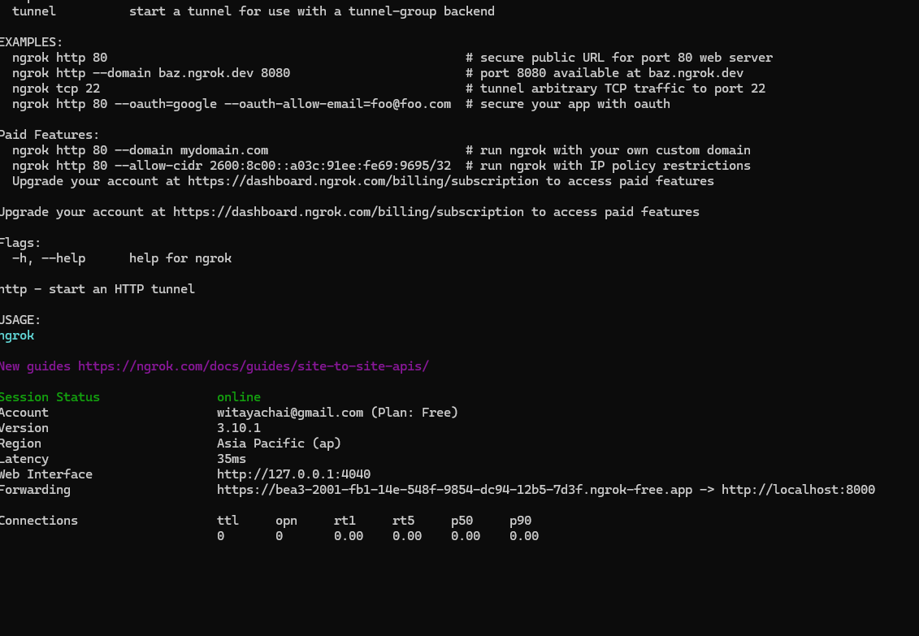
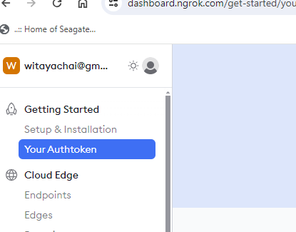

Slide 14
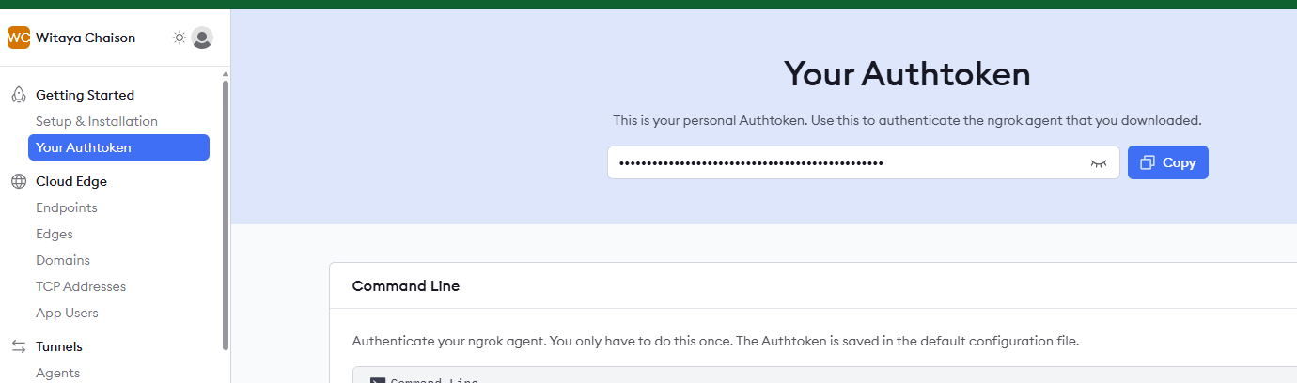

Slide 15
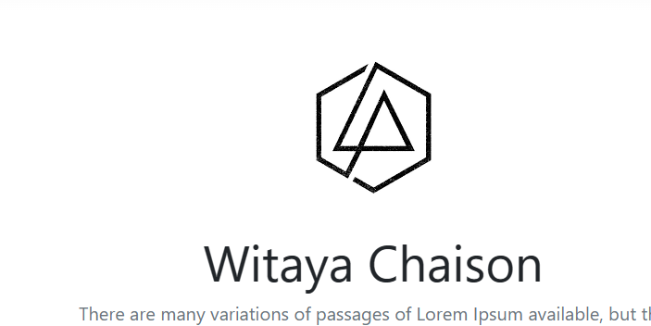
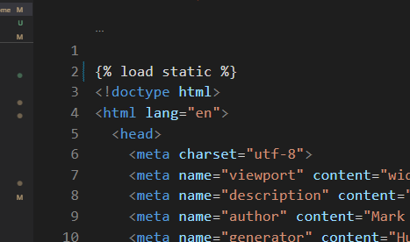
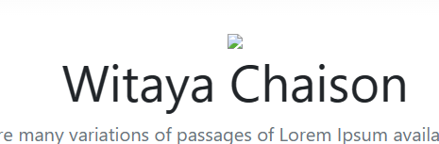
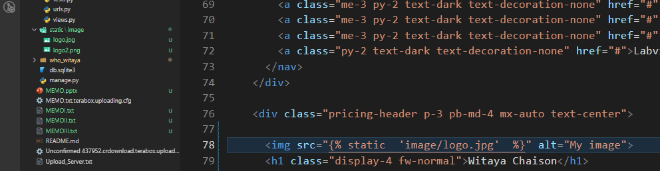
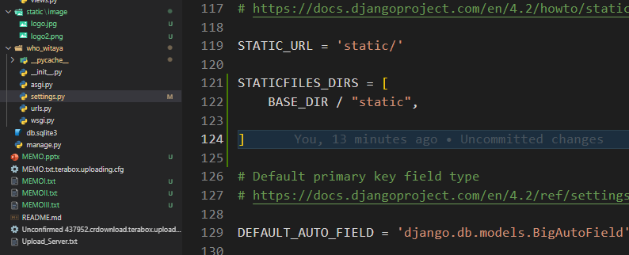
การใช้งานรูปภาพ
https://docs.djangoproject.com/en/3.2/howto/static-files/
- มี static URL ไหม
- 'django.contrib.staticfiles’ ไหม?
- Add { % load static % }
สร้าง Folder static ใน app หรือข้างนอก static/image/logo.png
Add static url and static flil _DIRs
This program is static folder > Image Folder > Image.png
Folder
Image /java scripts /CSS

Slide 16
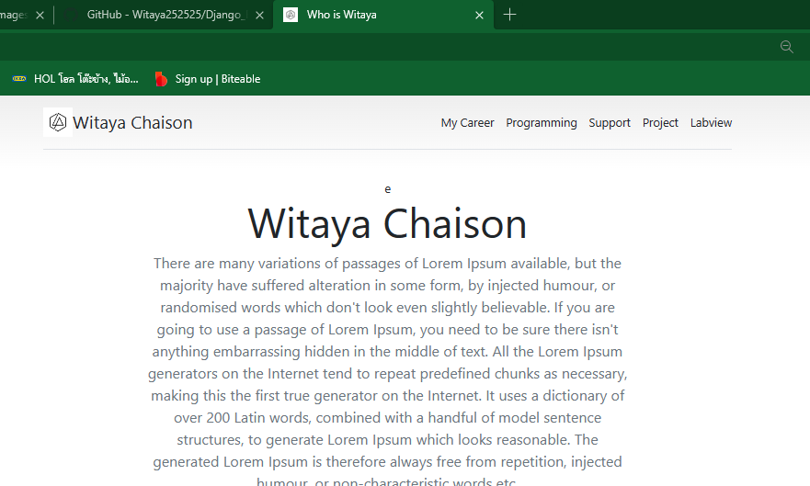
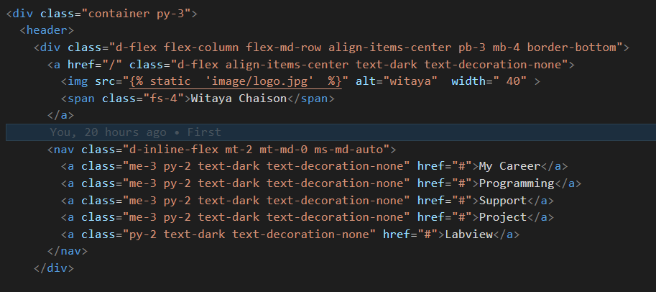
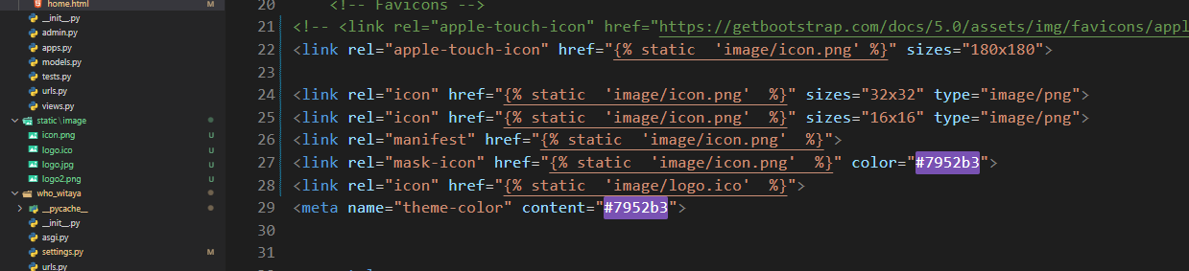
Favicon รูปใน tag ด้านบน ico file

Slide 17
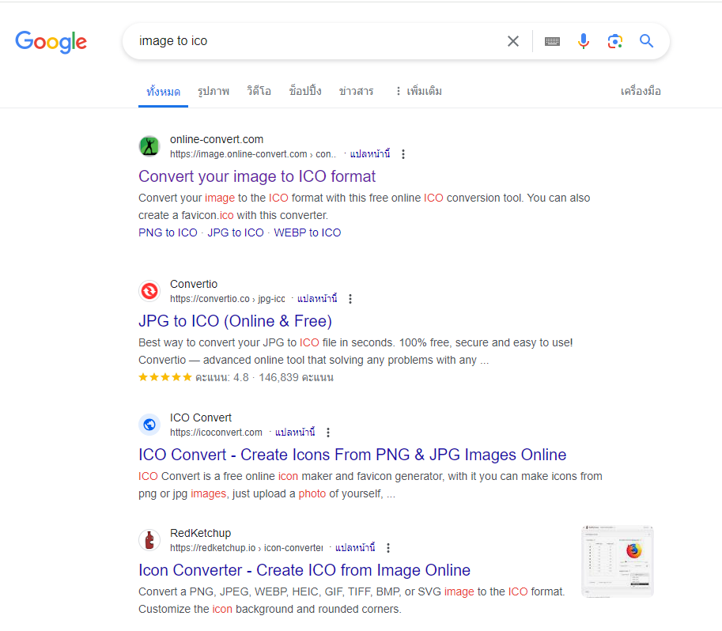

Slide 18
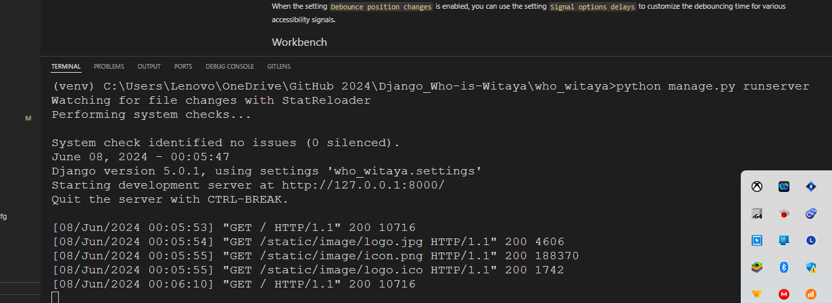

Slide 19
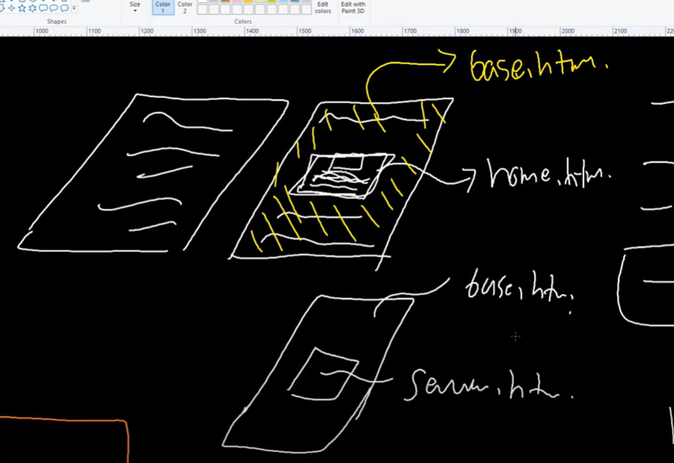
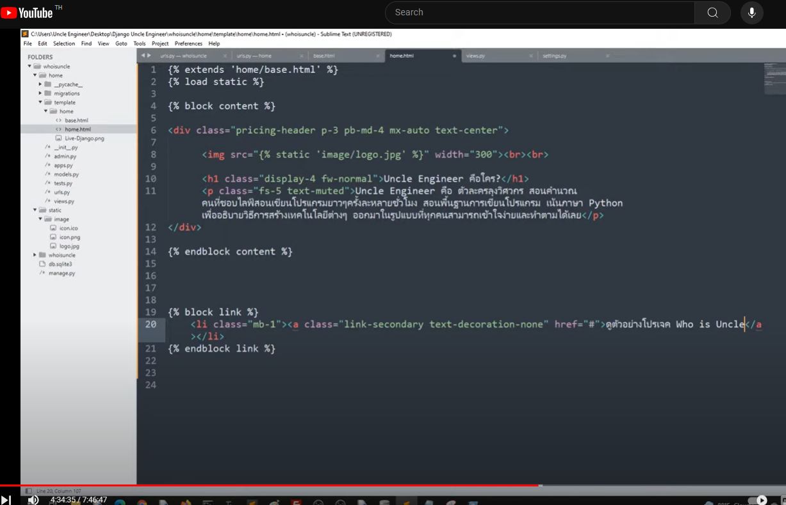
Link to base.html

Slide 20
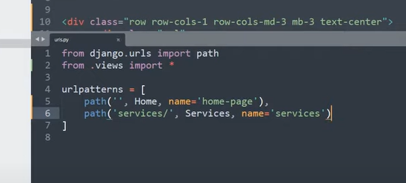
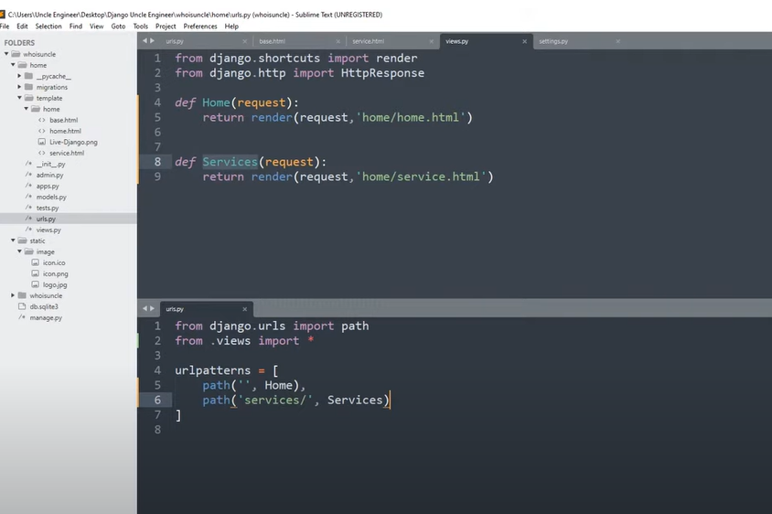
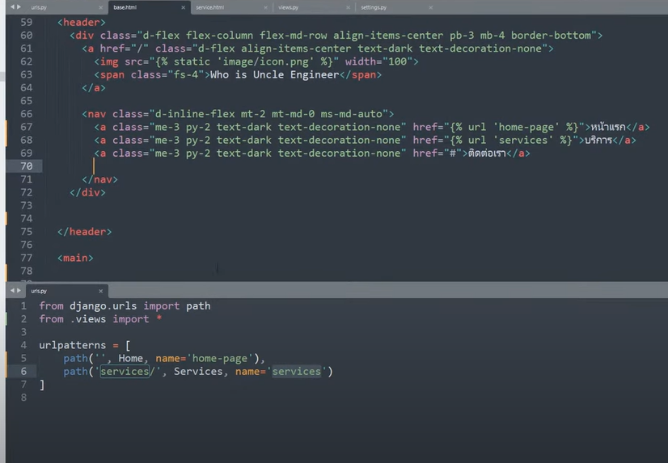
Create page more page
Add page on template and html file
Create function page ( service.html , contact.html )
Add name of urls in name = ‘ contact.html ’
{ url ‘contact.html ‘ }
Link_to name

Slide 21
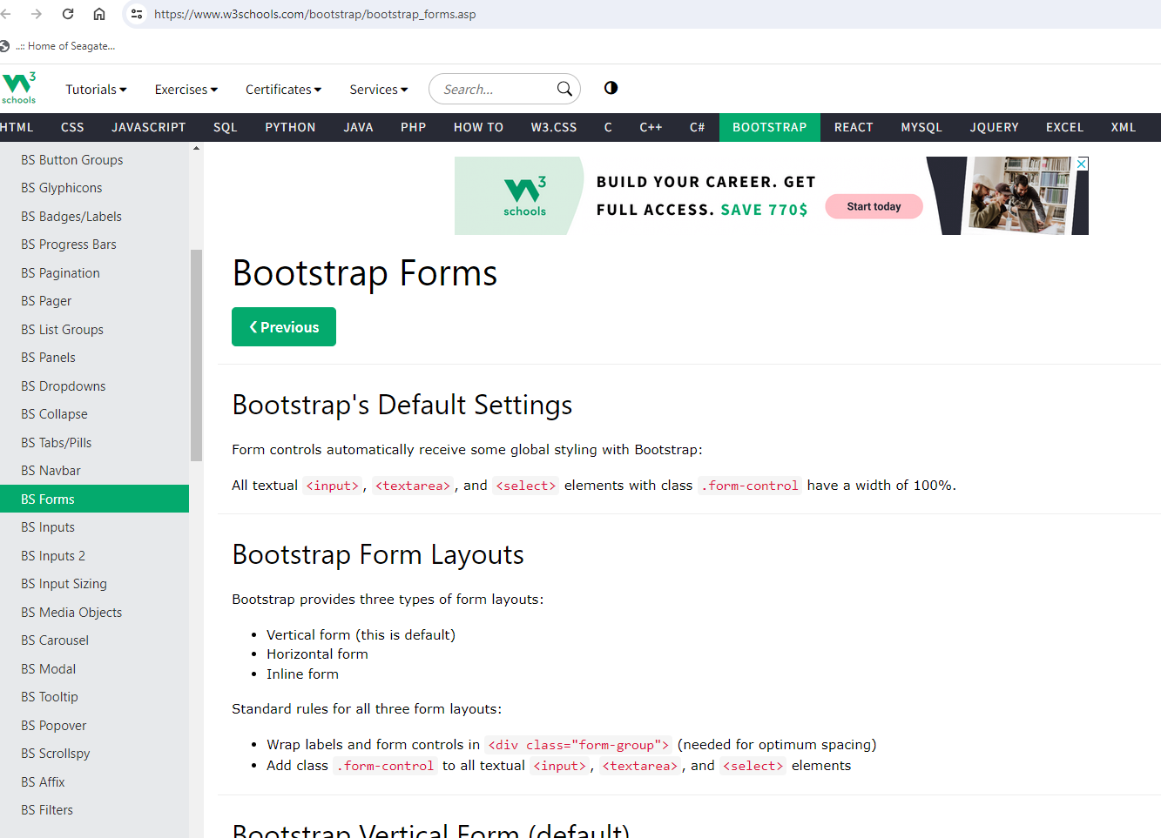
https://www.w3schools.com/bootstrap/bootstrap_forms.asp
การสร้าง Form
div class container
Class = “ form-control “
Class = “form-group”

Slide 22
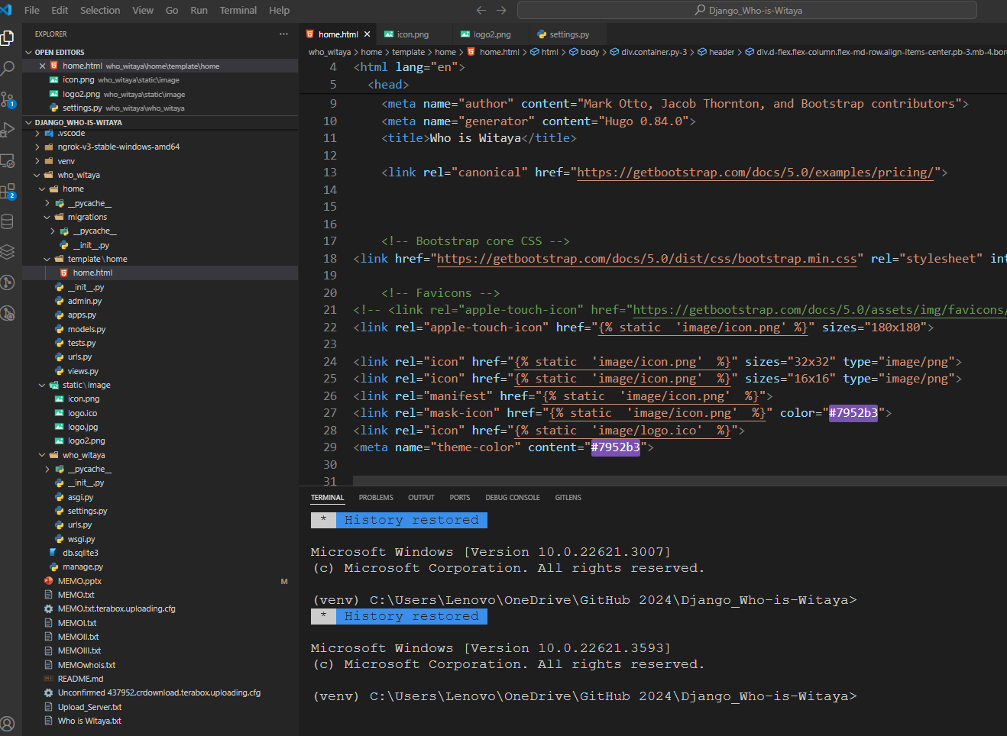

Slide 23
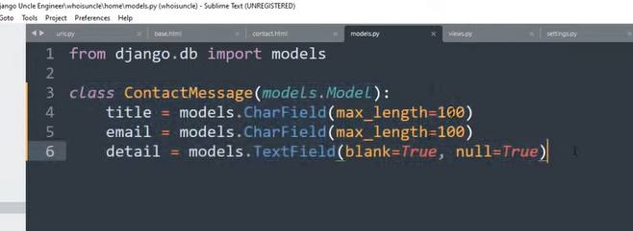
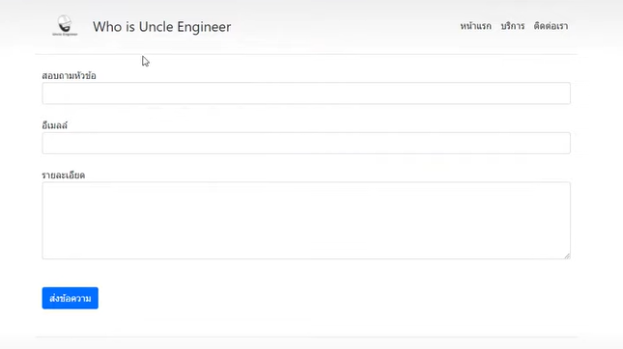
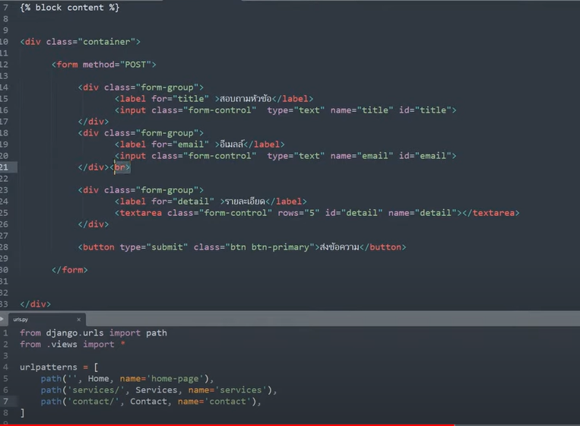
ใส่ Class from control in form ( input and texarea !!!

Slide 24
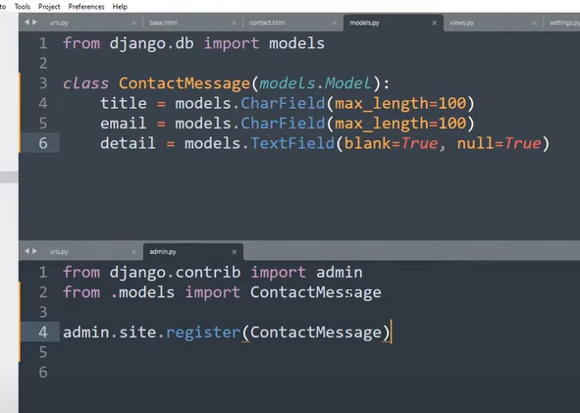

Slide 25
Def Contact(request)
if request. method == “ POST”
{ % csrf_token% }
data = request.POST.copy()
title = data.get(‘title’)
email = data.get(“email”)
details = data.get(“details”)
return render(request, “home/contact.html”

Slide 26
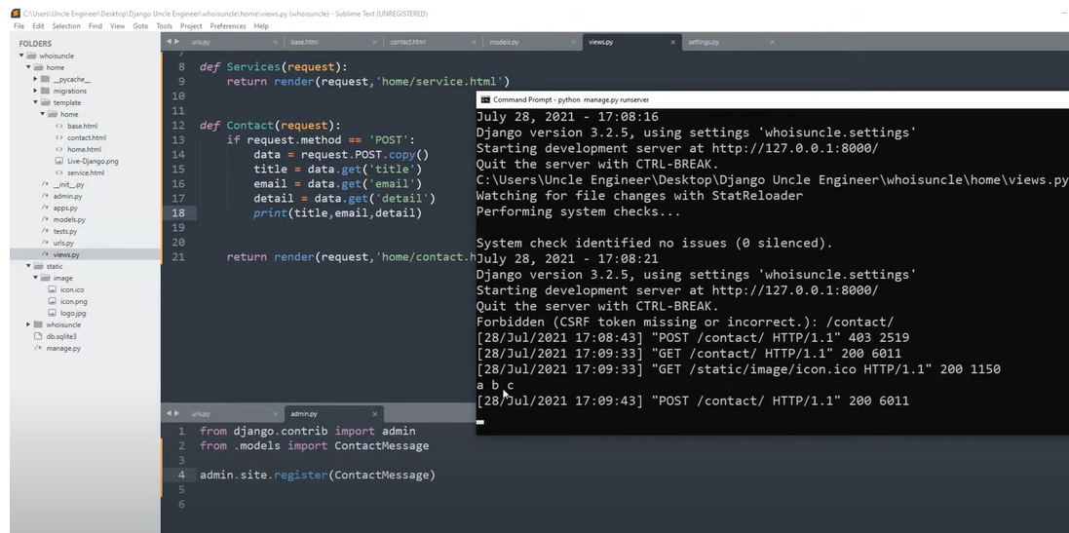
ใส่ข้อมูลลงใน Form ( on internet) But not create into database

Slide 27
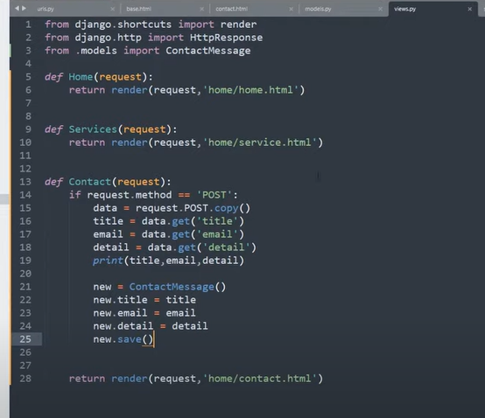
เขียนใส่ database

Slide 28
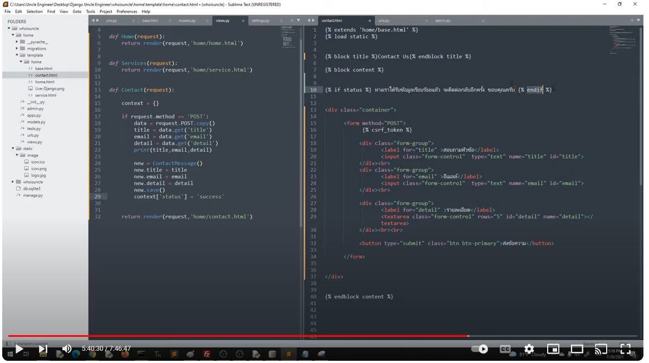
Context is dictionary

Slide 29

Contact.htmll
Views
ตรวจจับเวลาใส่ข้อมูลไม่ครบ

Slide 30


Slide 31

Add image
Separated Nav
Aug_31_2024

